Slide 1
Design and implementation of an Enterprise-Grade Wireless Network with Strong Authentication
Team:
Mugunthan, Abishek
Ravipati, Ajay Kumar
Rai, Roopesha Sheshappa
Nynala, Vijaya Laxmi Durga Alekhya
Advisor:
Saldamli, Gokay

Slide 2
Agenda:
WiFi
Introduction - WiFi systems
Enterprise WiFi and Security concerns
Aruba Enterprise Wireless Network
Hardware Setup
Physical and Logical connections
Configurations - IP and VLANs
Virtual Router Redundancy Protocol (VRRP)
Configuration - Control Plane Security
Wireless Encryption and Authentication
ESSID
Software implementation - Tools and Utilities
Testing
Limitations and Future work

Slide 3
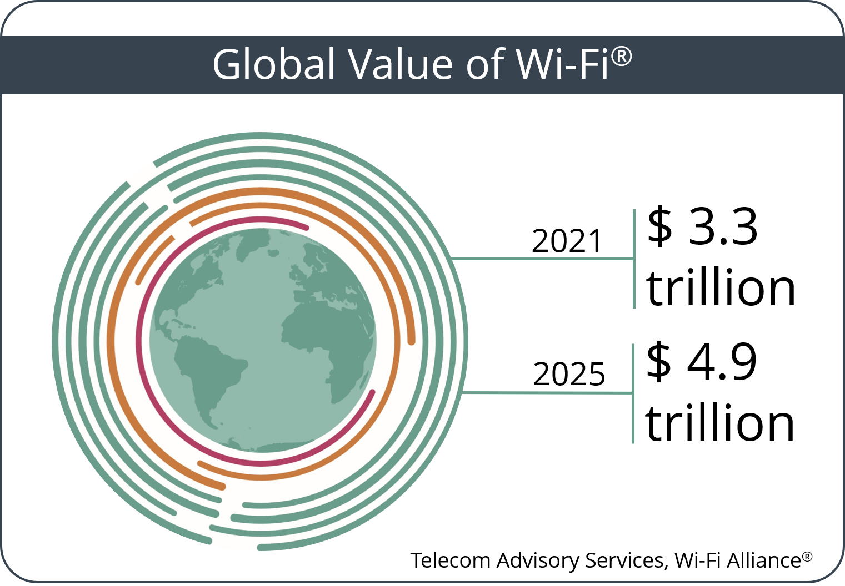
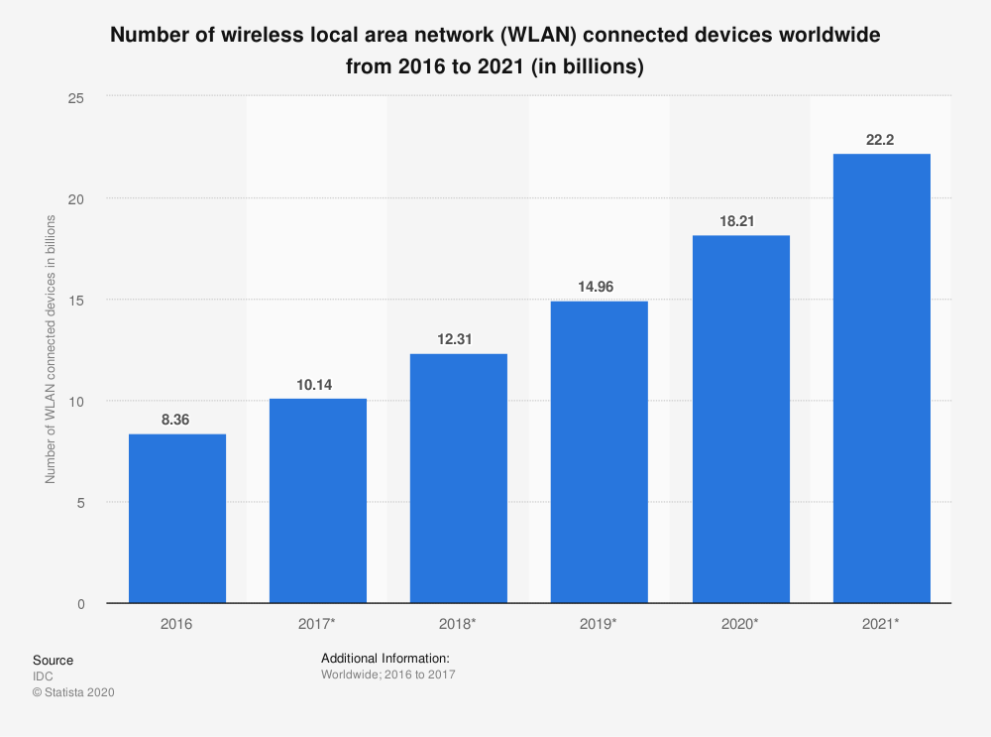
WiFi
It is difficult to imagine day without WiFi
WiFi presence increasing as growing number of IoT devices
Workplaces uses WiFi for telepresence and connectivity
Airport and airlines uses it for their tools for efficient management
School uses WiFi - Virtual classes, education based on VR
Factory uses it for tracking resources

Slide 4
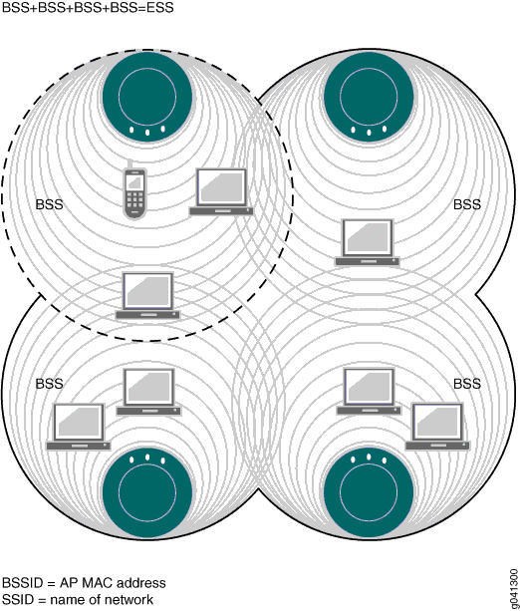
Introduction - WiFi systems
Devices connects to the Access Point wirelessly to access internet
Wireless technology based on 802.11 family of standards
Uses radio waves to transmit the data
Works on 2.4GHz, 5Ghz and now 6GHz
Multiple devices uses common shared wireless media. So any devices can listen to traffic in its vicinity
Service Set: Set of devices in a WiFi network, Identified using SSID
BSSID - Basic Service Set Identifier
Image Source

Slide 5
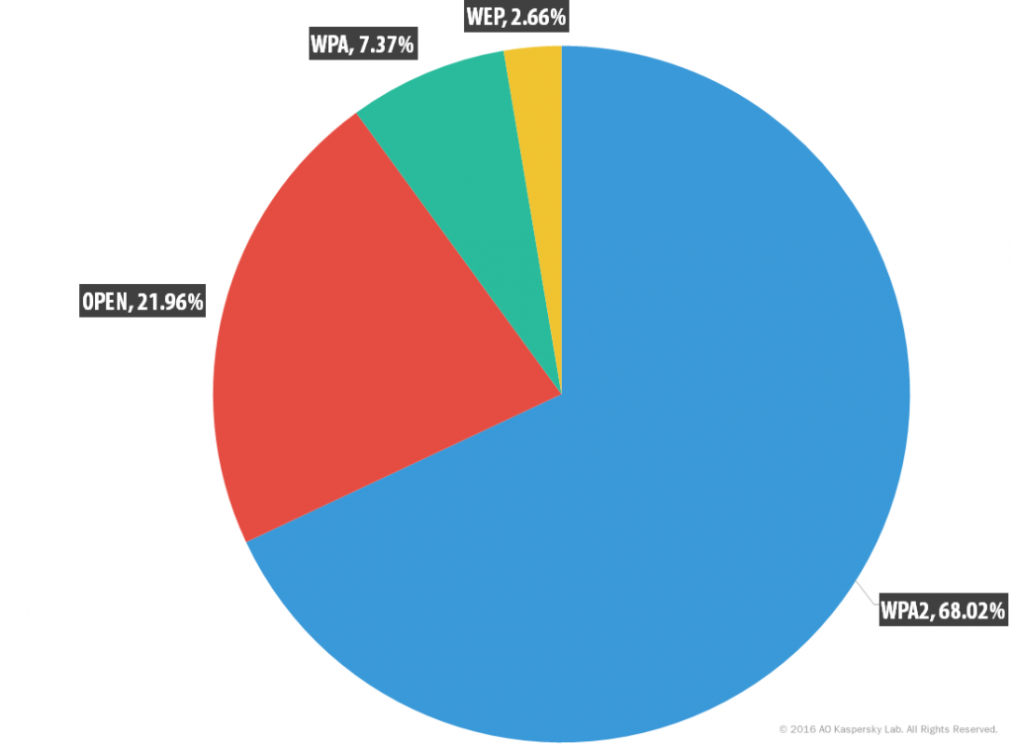
Enterprise WiFi and Security concerns
Serves large set of users by enterprise. Companies, universities, governments…
Security breach on these network can bring down organization down
Misconfiguration on these network leads to security vulnerabilities.

Slide 6
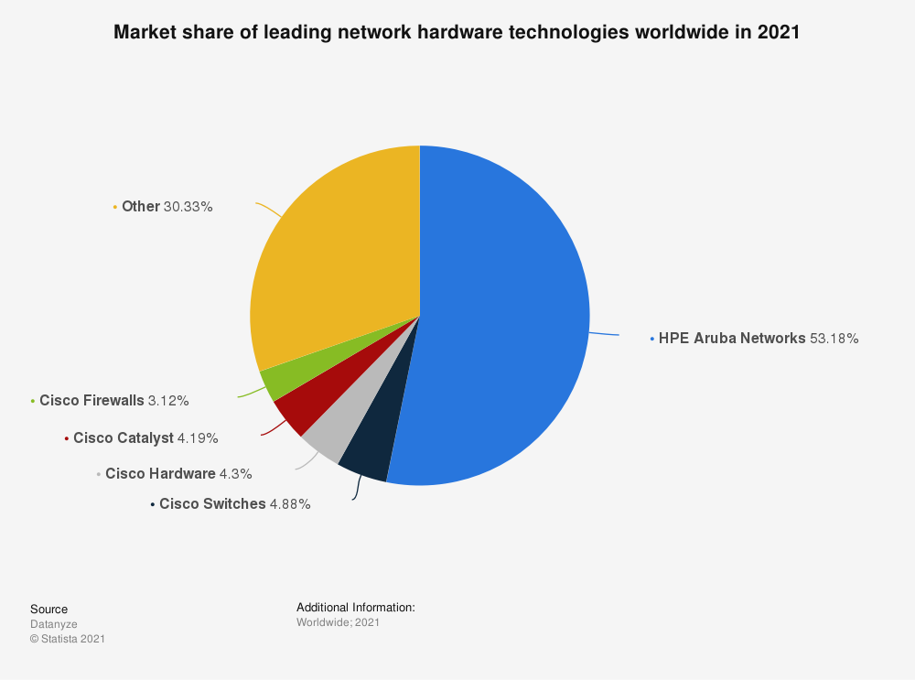
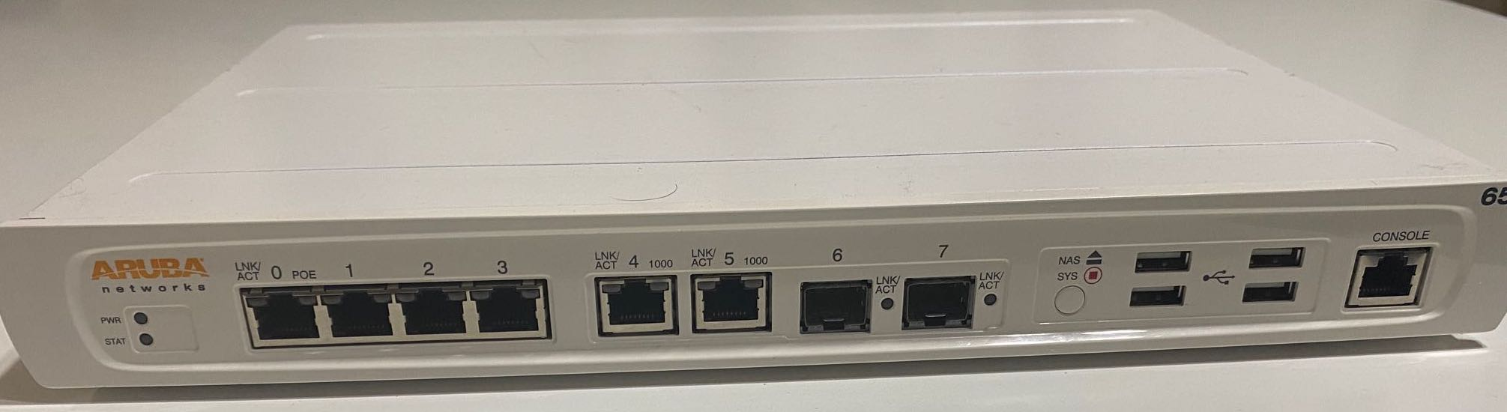
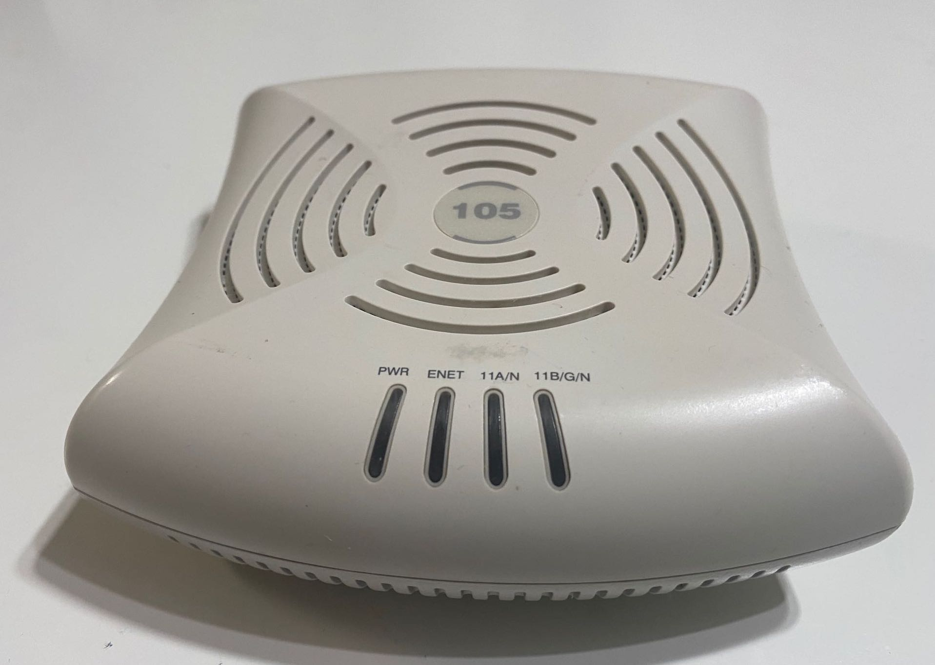
Aruba Enterprise Wireless Network
Controller: Aruba 650
Branch office controller
8 port ethernet switch with POE, IP router
Supports 16 APs, 512 users, 128 VLAN IP interfaces
Access Point: AP-105
IEEE 802.11n, MIMO
Works only with Aruba controller

Slide 7
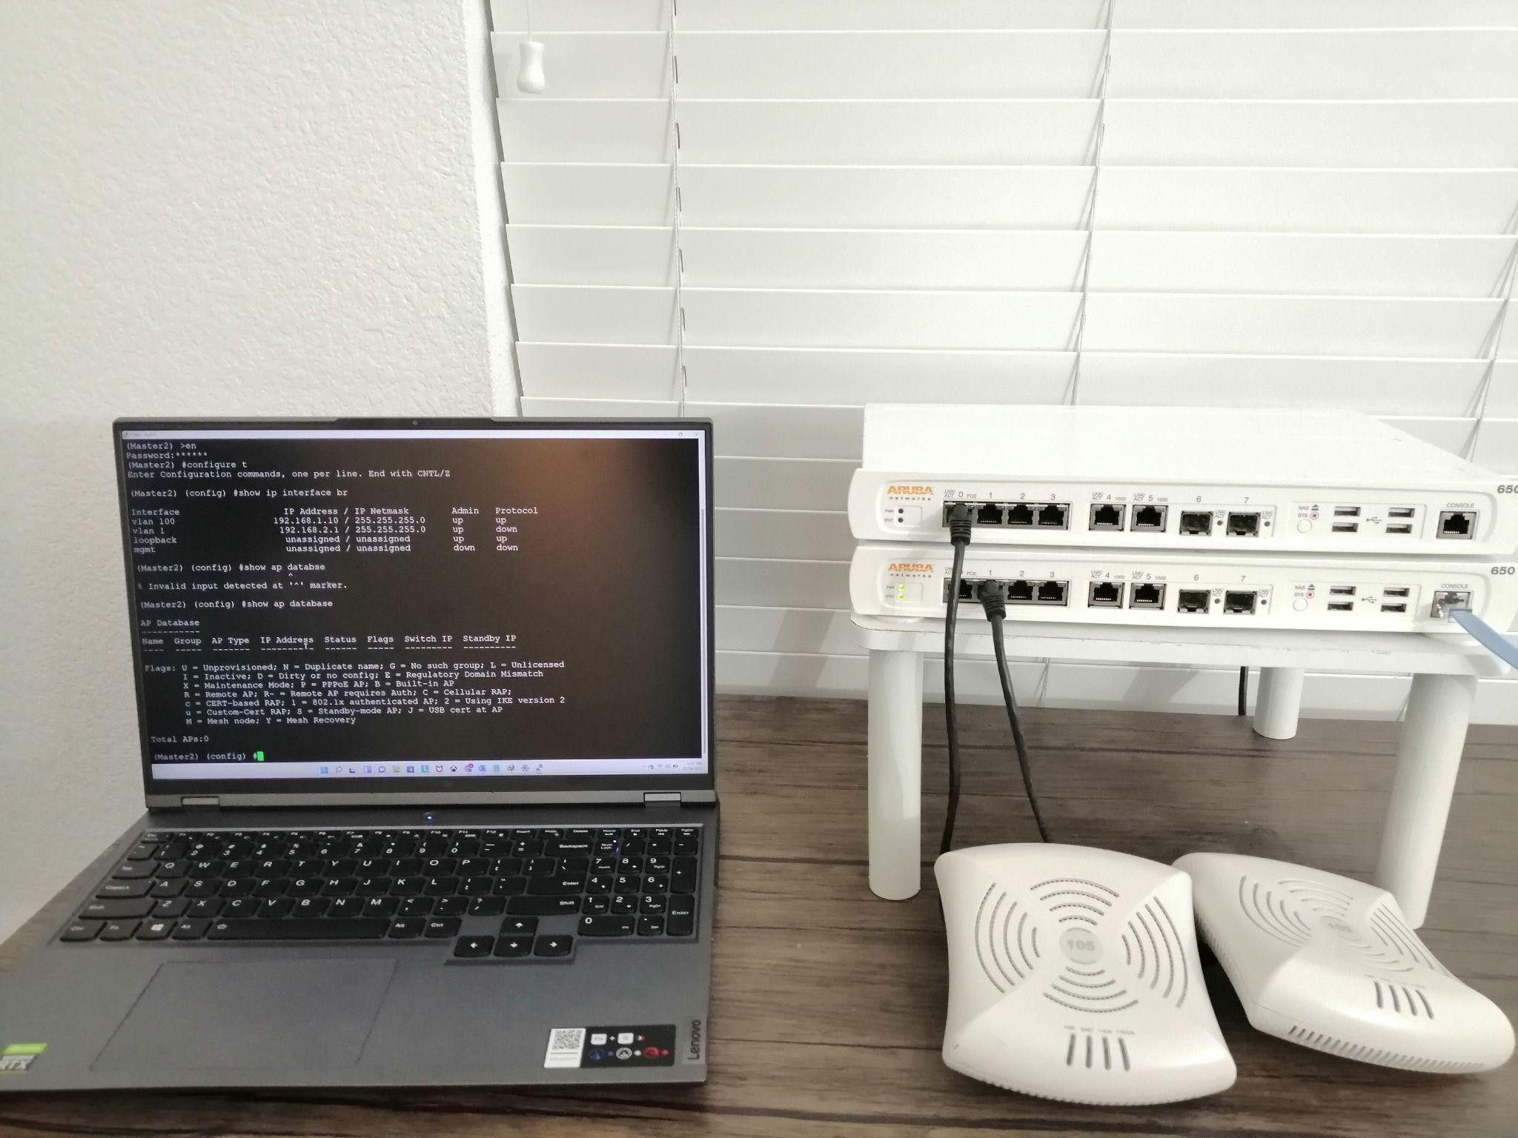
Hardware Setup

Slide 8
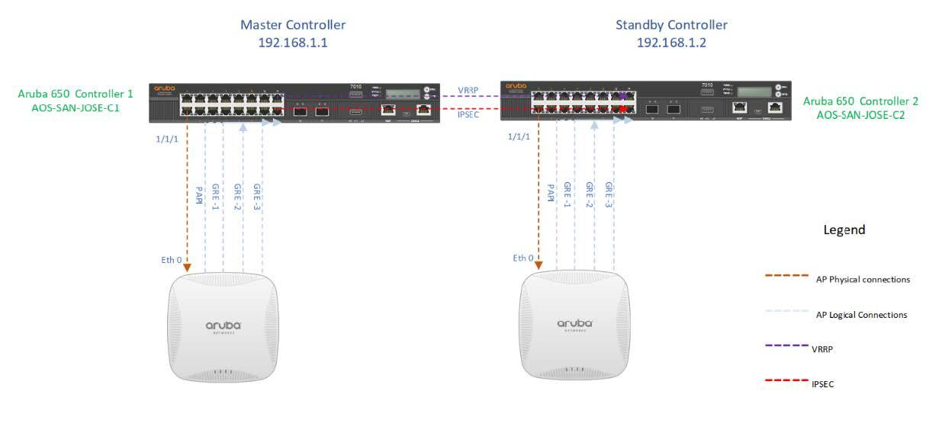
Physical and Logical connections

Slide 9
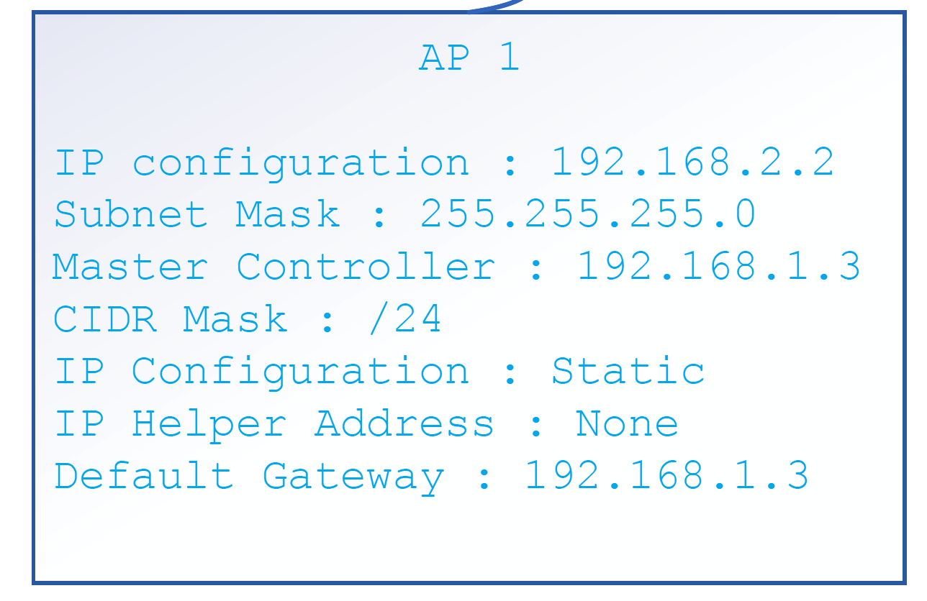
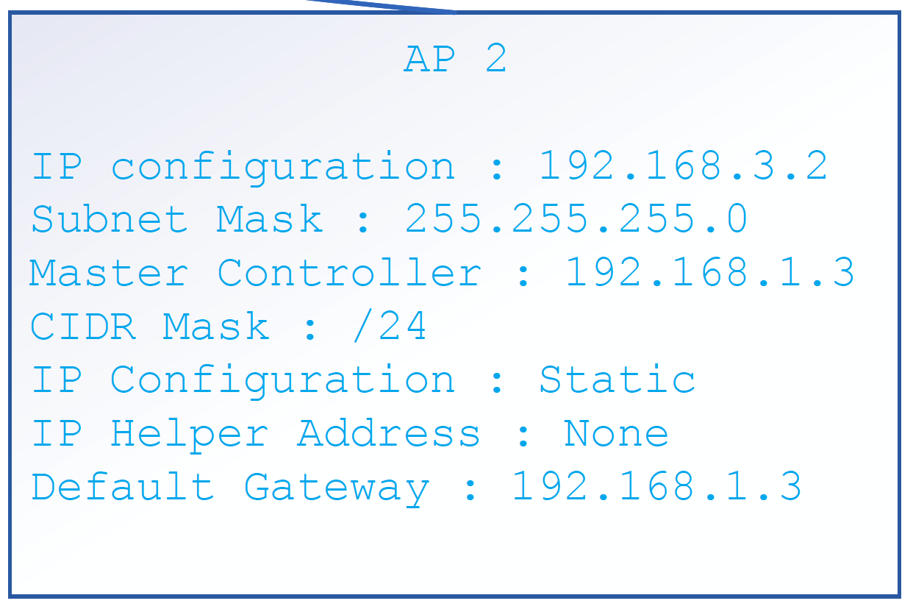
Configurations - IP and VLANs
Master Controller IP - 192.168.1.1
Standby Controller IP - 192.168.1.2
VRRP IP - 192.168.1.3
VLANs
VLAN 100 - 192.168.4.0/24
VLAN 200 - 192.168.5.0/24
VLAN 300 - 192.168.6.0/24
VLAN 400 - 192.168.7.0/24
VLAN 800 - 192.168.11.0/24
VLAN 700 - 192.168.10.0/24
VLAN 600 - 192.168.9.0/24
VLAN 500 - 192.168.8.0/24

Slide 10
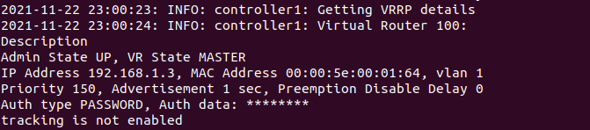
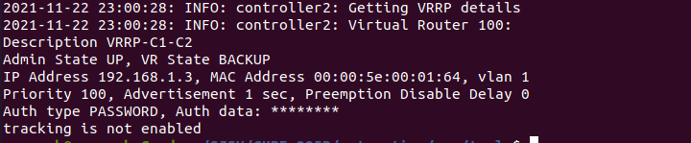
Virtual Router Redundancy Protocol (VRRP)
VRRP eliminates a single point of failure
Using VRRP, a backup device can take over a failed default device within a few seconds
Devices running VRRP dynamically elect primary and backup devices or can be done by assigning priority numbers from 1 to 255

Slide 11
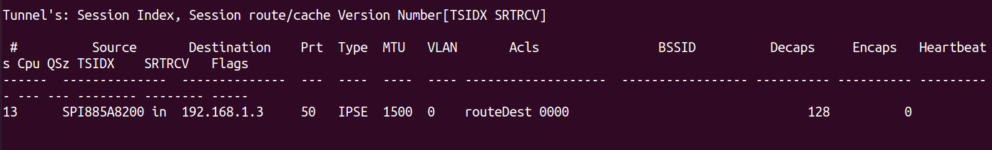
Configuration - Control Plane Security
Controller uses secured IPSec communication between managed devices and AP.

Slide 12
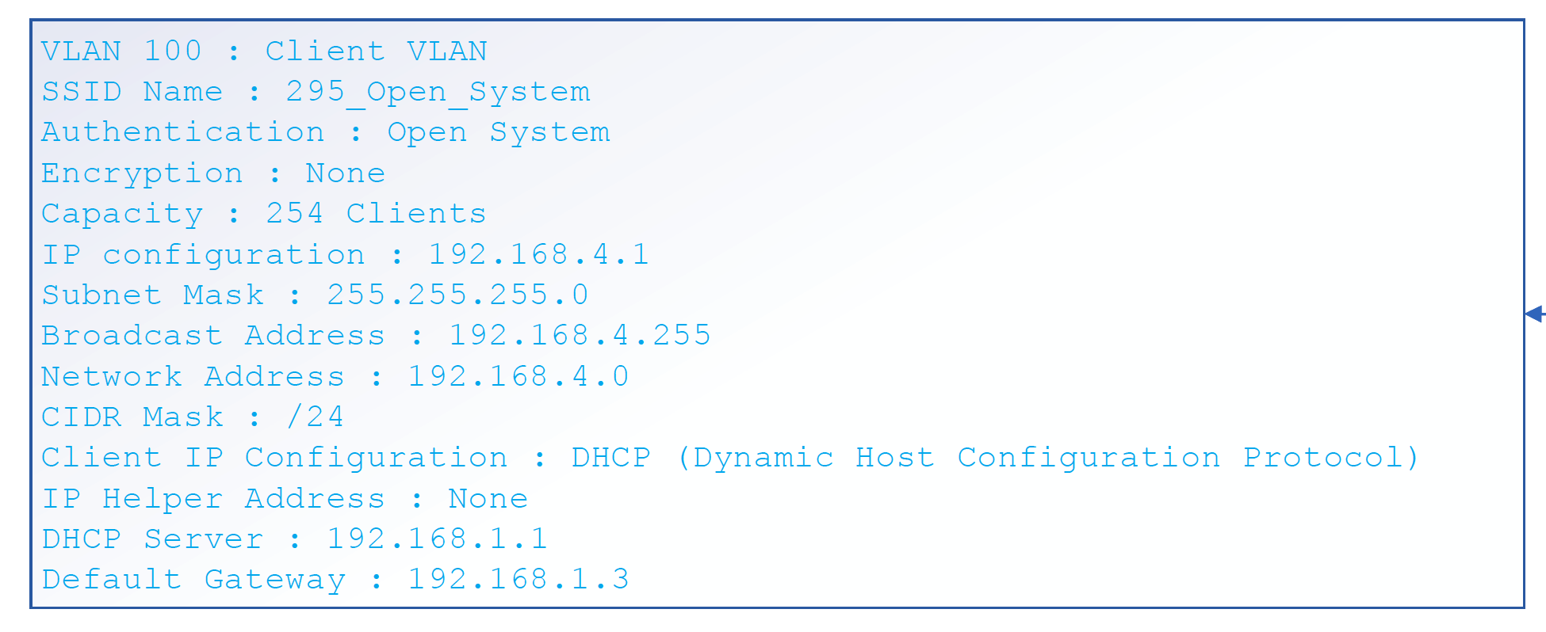
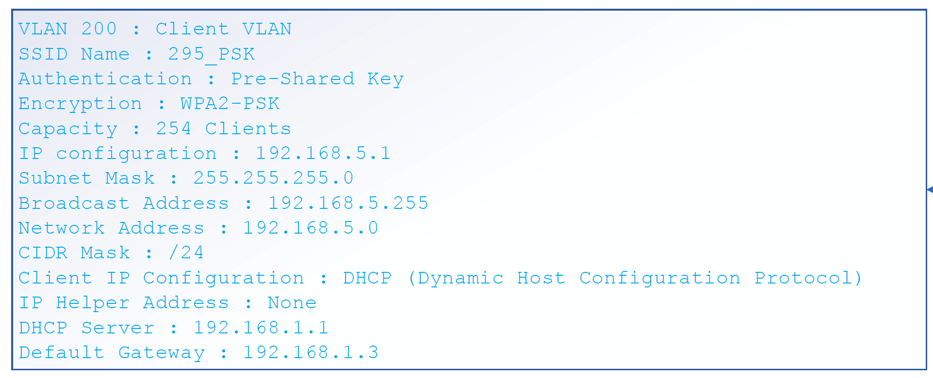
Wireless Encryption and Authentication
Open System Authentication
Pre-Shared Key - WPA2

Slide 13
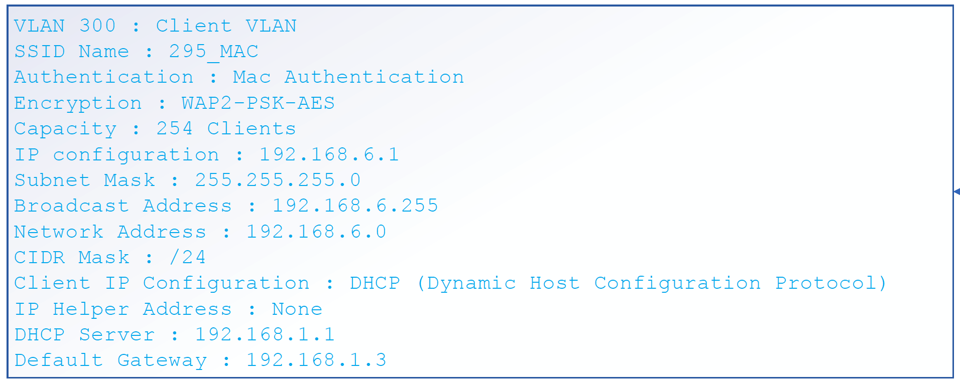
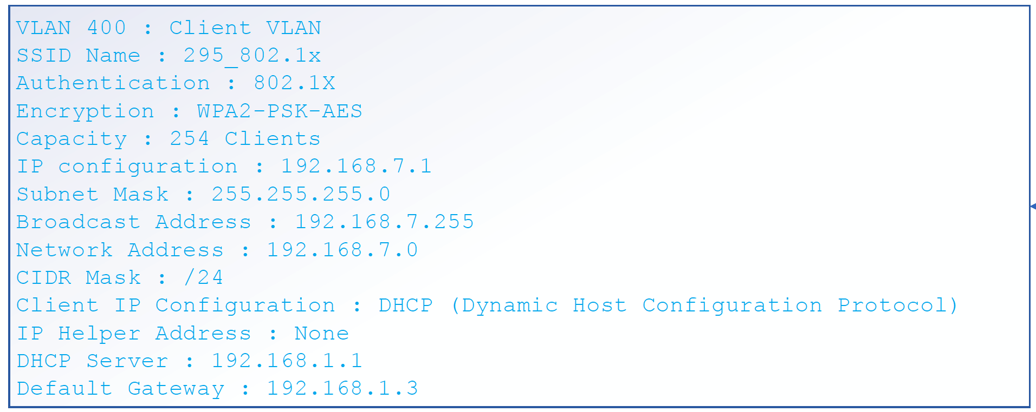
Wireless Encryption and Authentication
MAC Authentication - WPA2 PSK AES
802.1X - WPA2 PSK AES

Slide 14
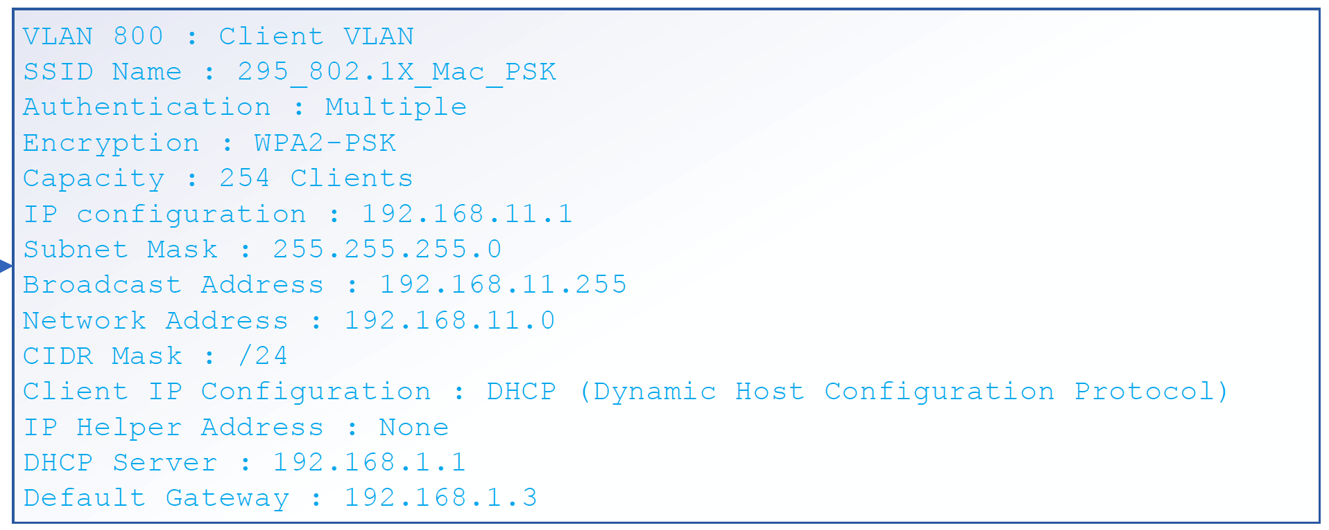
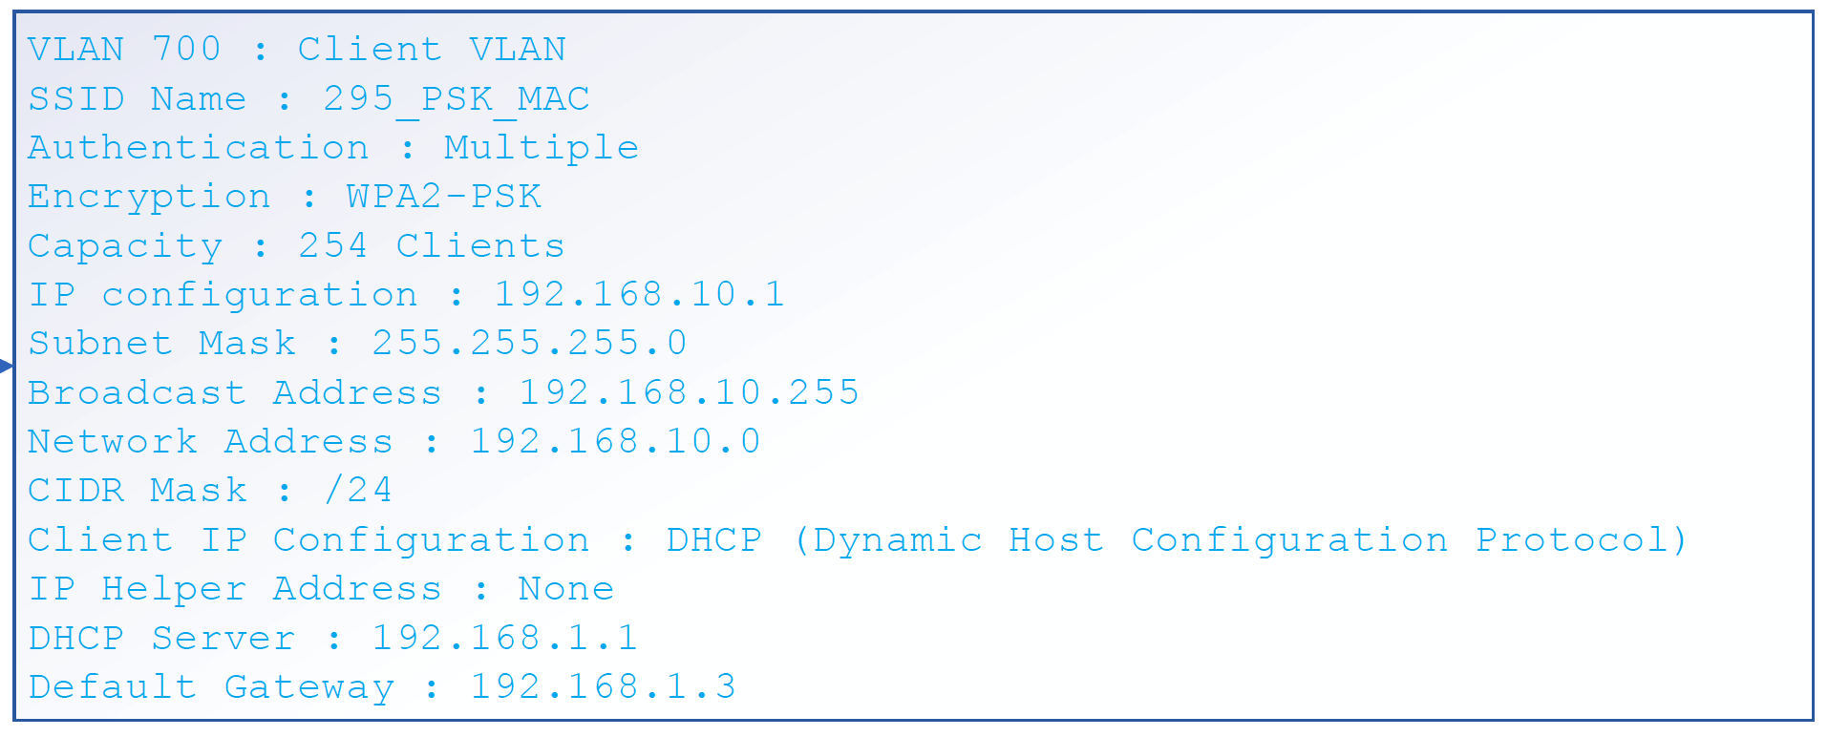
Wireless Encryption and Authentication
Multiple-802.1X + MAC Auth + WPA2 PSK
Multiple - MAC Auth + WPA2 PSK

Slide 15
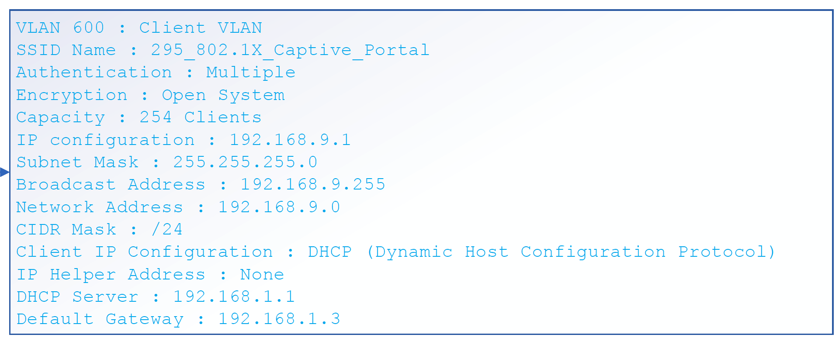
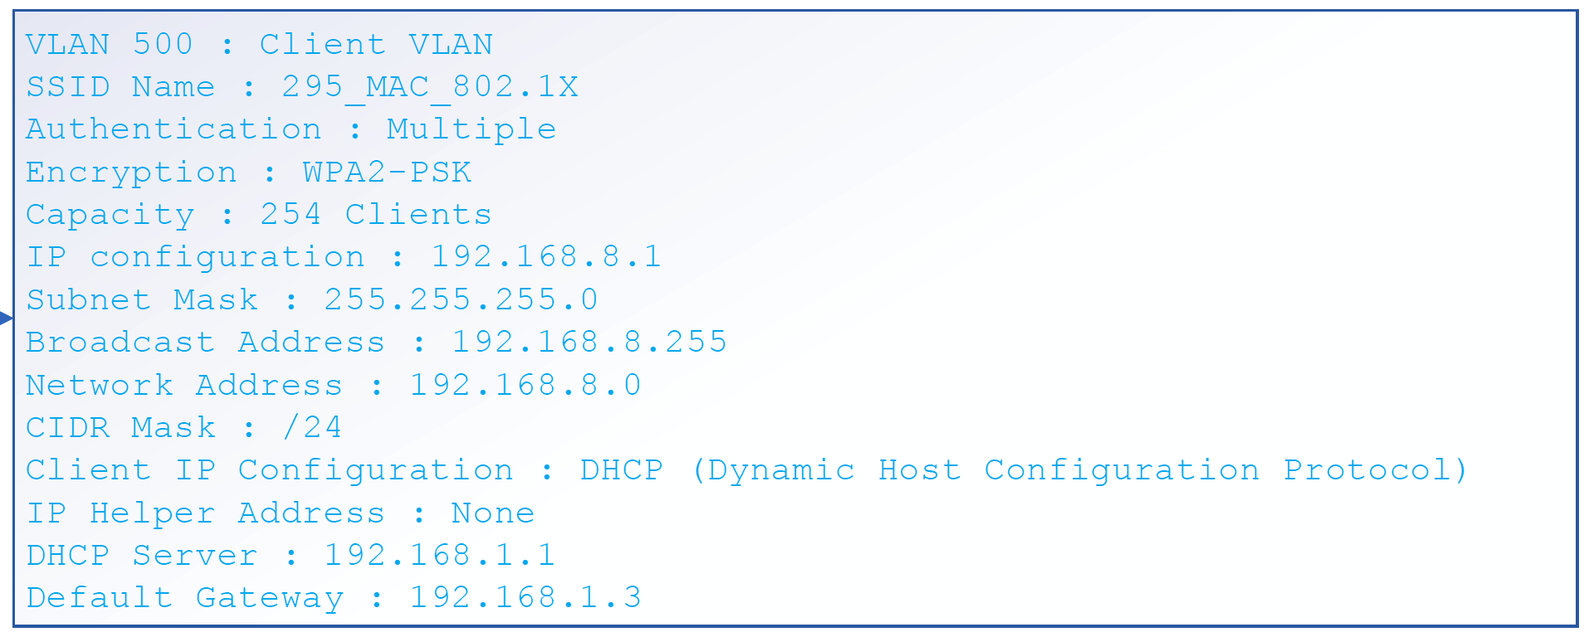
Wireless Encryption and Authentication
Multiple-802.1X + MAC Auth + PSK
Multiple - MAC Auth + WPA2 PSK

Slide 16
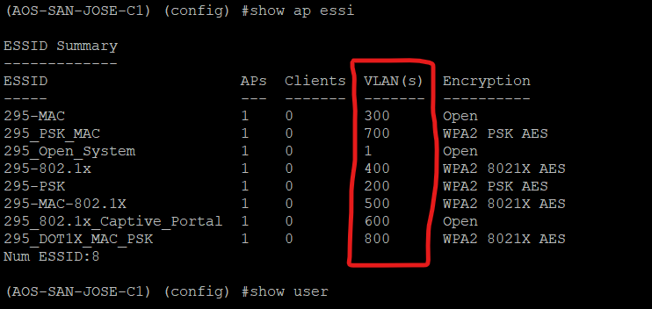
ESSID

Slide 17
Software implementation - Tools and Utilities
Legacy controllers are slow. If we have multiple controller it takes time to configure.
We developed a automation tool using Python to control these devices.
It has extensive libraries to manage the controller using serial and running CLI commands.
Identifies controllers using YAML based configuration
Source: https://github.com/roopesh-rai-s-2/CMPE-295B-SECURED-ENTERPRISE-WIFI/tree/main/automation
Client side testing we did using nmcli command based scripts from the Linux machine.

Slide 18
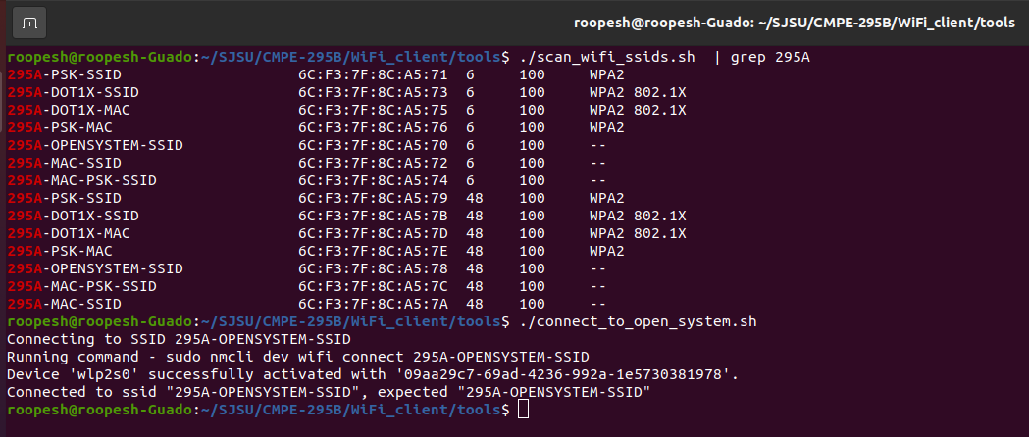
Testing - Open System Authentication

Slide 19
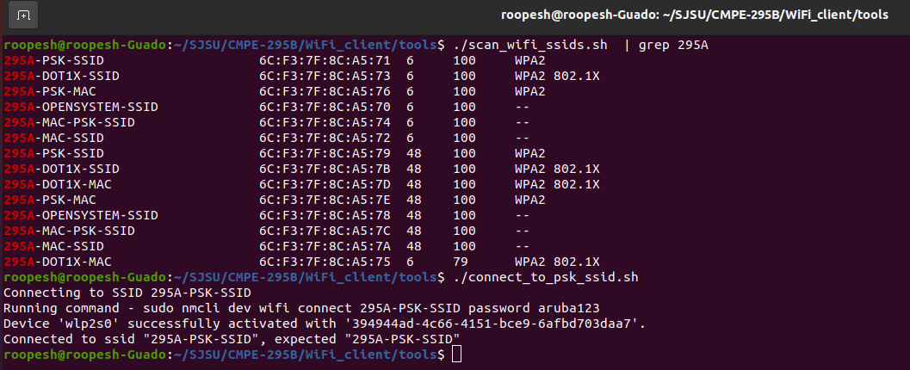
Testing - WPA2 PSK

Slide 20
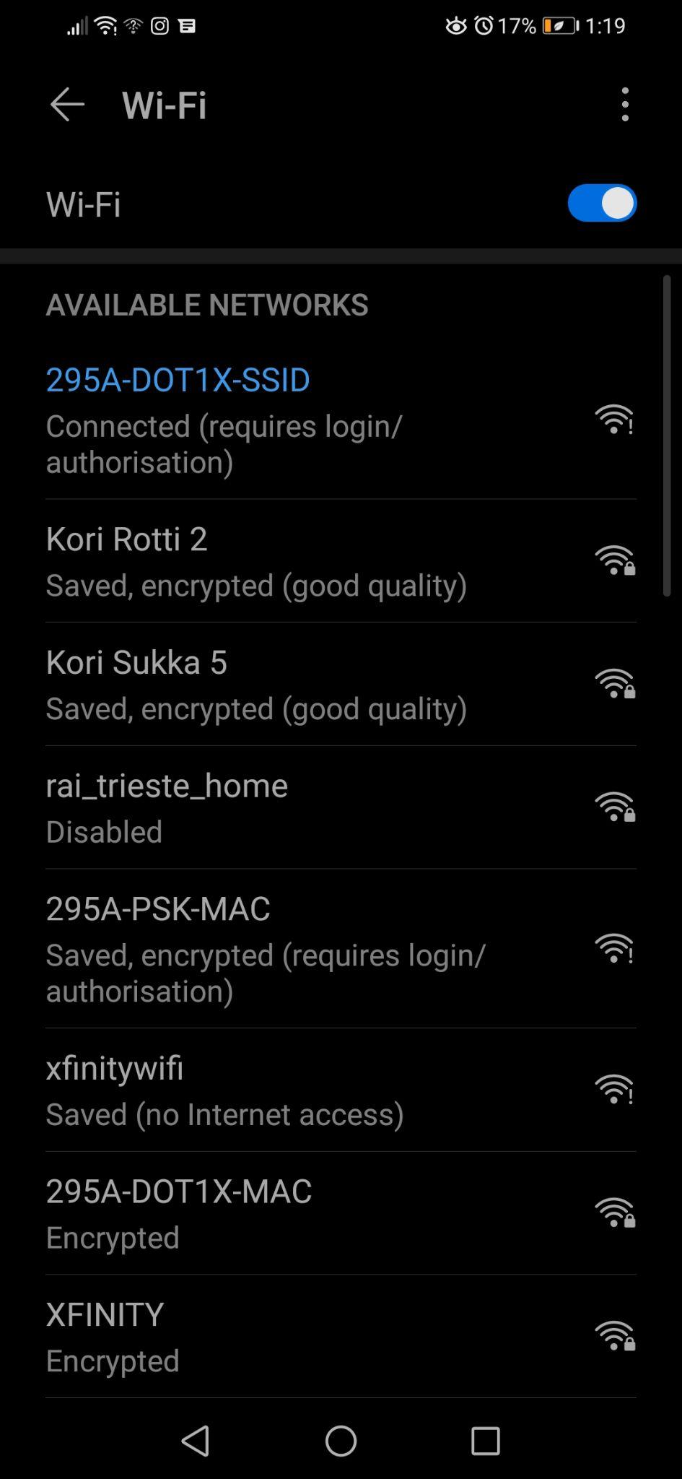
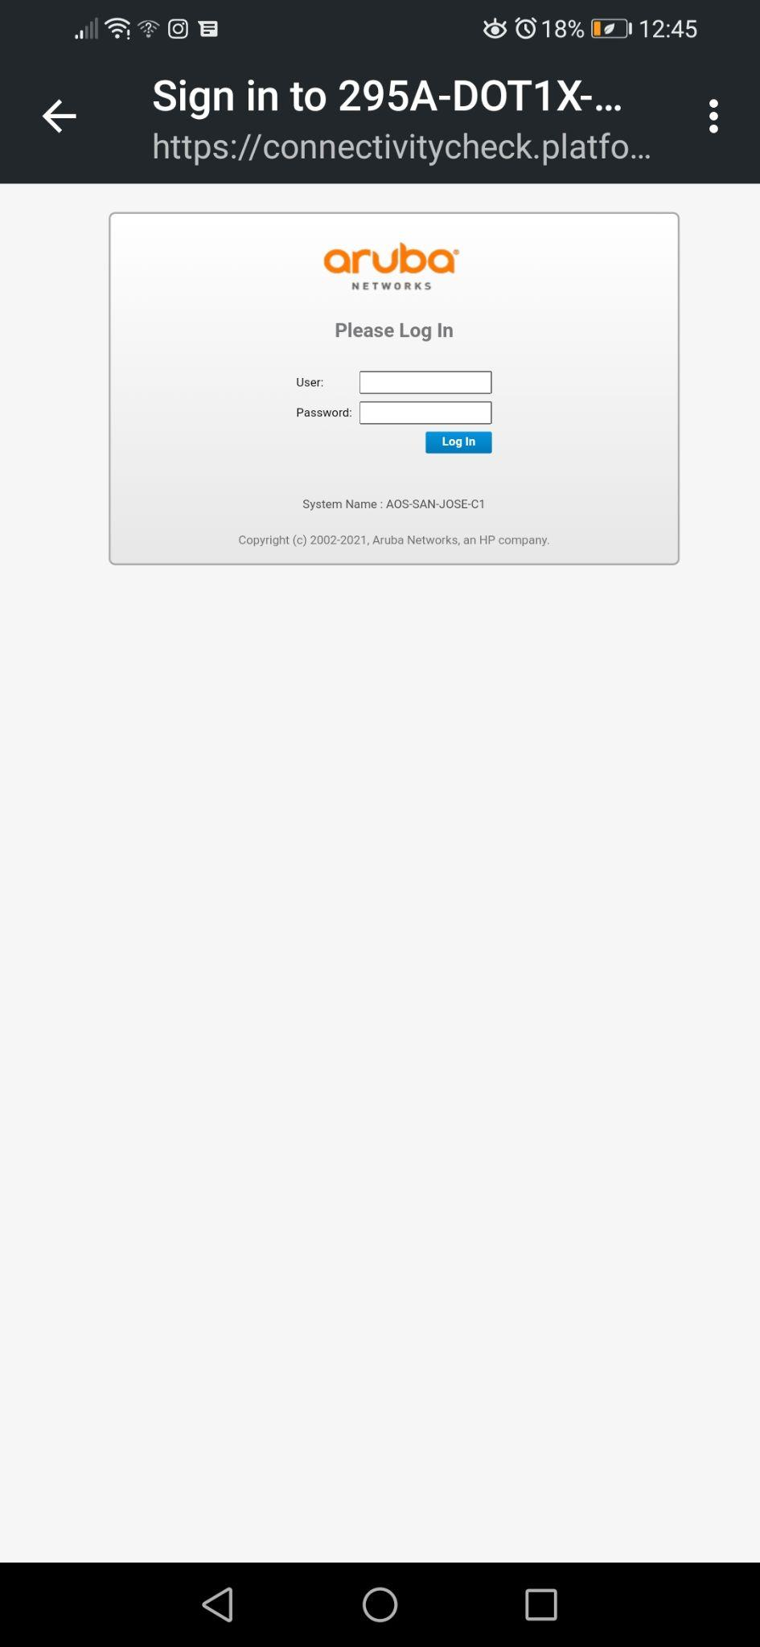
Testing - 802.1X

Slide 21
Limitations and Future work
We did experiment with legacy Aruba devices. Default OS doesn't support advanced security features.
Newer Enterprise hardwares are expensive and costs licenses.
Simulate attacks and make sure configuration is stable enough to provide security

Slide 22
References
Understanding the Network Terms SSID, BSSID, and ESSID
https://www.wi-fi.org/discover-wi-fi/value-of-wi-fi
https://securelist.com/research-on-unsecured-wi-fi-networks-across-the-world/76733/
https://www-statista-com.libaccess.sjlibrary.org/statistics/802706/world-wlan-connected-device/
https://www-statista-com.libaccess.sjlibrary.org/statistics/1258679/network-hardware-market-share-technology-worldwide/

Slide 23
Demo…

